Slide 1
Operating Systems Concepts

Slide 2
A Computer Model
An operating system has to deal with the fact that a computer is made up of a CPU, random access memory (RAM), input/output (I/O) devices, and long-term storage.
RAM
0
1
2
3
4
5
6
7
8
9
.
.
.
Disk Drive
I/O
CPU

Slide 3
OS Concepts
An operating system (OS) provides the interface between the users of a computer and that computer’s hardware.
An operating system manages the ways applications access the resources in a computer, including its disk drives, CPU, main memory, input devices, output devices, and network interfaces.
An operating system manages multiple users.
An operating system manages multiple programs.

Slide 4
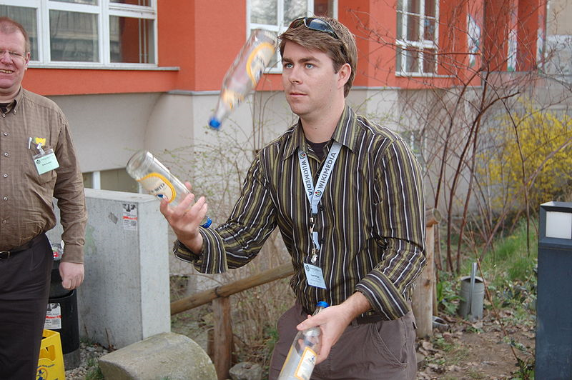
Multitasking
Give each running program a “slice” of the CPU’s time.
The CPU is running so fast that to any user it appears that the computer is running all the programs simultaneously.
Public domain image from http://commons.wikimedia.org/wiki/File:Chapters_meeting_2009_Liam_juggling.JPG

Slide 5
The Kernel
The kernel is the core component of the operating system. It handles the management of low-level hardware resources, including memory, processors, and input/output (I/O) devices, such as a keyboard, mouse, or video display.
Most operating systems define the tasks associated with the kernel in terms of a layer metaphor, with the hardware components, such as the CPU, memory, and input/output devices being on the bottom, and users and applications being on the top.
User Applications
Userland
Non-essential OS Applications
Operating System
The OS Kernel
CPU, Memory, Input/Output
Hardware

Slide 6
Input/Output
The input/output devices of a computer include things like its keyboard, mouse, video display, and network card, as well as other more optional devices, like a scanner, Wi-Fi interface, video camera, USB ports, etc.
Each such device is represented in an operating system using a device driver, which encapsulates the details of how interaction with that device should be done.
The application programmer interface (API), which the device drivers present to application programs, allows those programs to interact with those devices at a fairly high level, while the operating system does the “heavy lifting” of performing the low-level interactions that make such devices actually work.

Slide 7
System Calls
User applications don’t communicate directly with low-level hardware components, and instead delegate such tasks to the kernel via system calls.
System calls are usually contained in a collection of programs, that is, a library such as the C library (libc), and they provide an interface that allows applications to use a predefined series of APIs that define the functions for communicating with the kernel.
Examples of system calls include those for performing file I/O (open, close, read, write) and running application programs (exec).

Slide 8
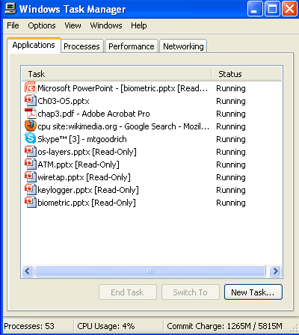
Processes
A process is an instance of a program that is currently executing.
The actual contents of all programs are initially stored in persistent storage, such as a hard drive.
In order to be executed, a program must be loaded into random-access memory (RAM) and uniquely identified as a process.
In this way, multiple copies of the same program can be run as different processes.
For example, we can have multiple copies of MS Powerpoint open at the same time.

Slide 9
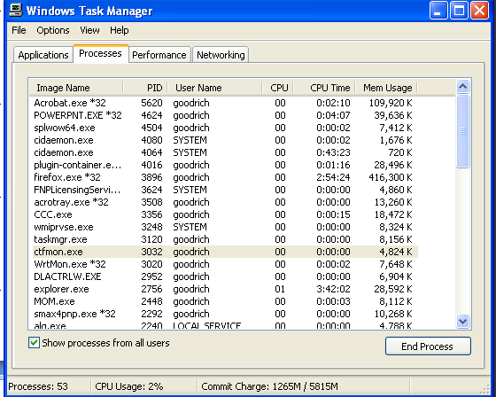
Process IDs
Each process running on a given computer is identified by a unique nonnegative integer, called the process ID (PID).
Given the PID for a process, we can then associate its CPU time, memory usage, user ID (UID), program name, etc.

Slide 10
File Systems
A filesystem is an abstraction of how the external, nonvolatile memory of the computer is organized.
Operating systems typically organize files hierarchically into folders, also called directories.
Each folder may contain files and/or subfolders.
Thus, a volume, or drive, consists of a collection of nested folders that form a tree.
The topmost folder is the root of this tree and is also called the root folder.

Slide 11
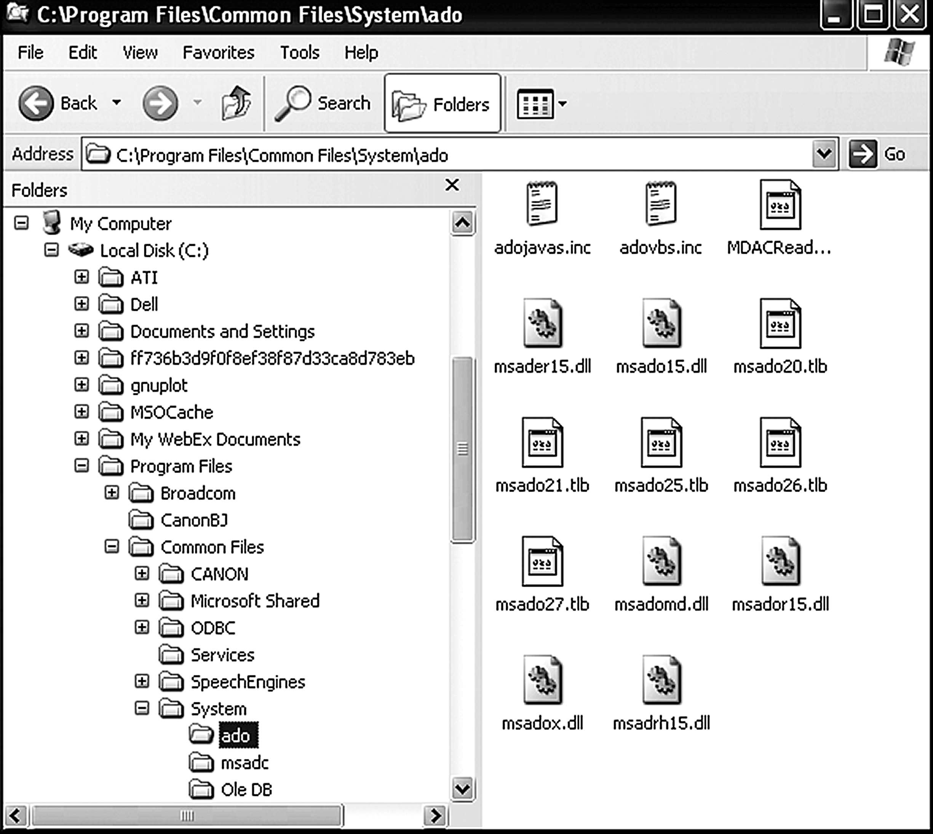
File System Example

Slide 12
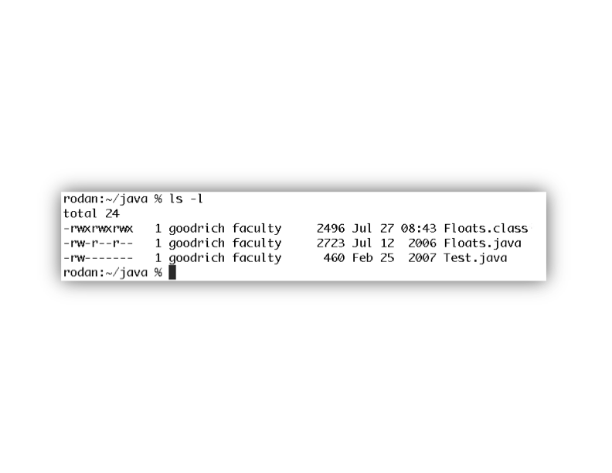
File Permissions
File permissions are checked by the operating system to determine if a file is readable, writable, or executable by a user or group of users.
In Unix-like OS’s, a file permission matrix shows who is allowed to do what to the file.
Files have owner permissions, which show what the owner can do, and group permissions, which show what some group id can do, and world permissions, which give default access rights.

Slide 13
Memory Management
The RAM memory of a computer is its address space.
It contains both the code for the running program, its input data, and its working memory.
For any running process, it is organized into different segments, which keep the different parts of the address space separate.
As we will discuss, security concerns require that we never mix up these different segments.

Slide 14
Memory Organization
Text. This segment contains the actual (binary) machine code of the program.
Data. This segment contains static program variables that have been initialized in the program code.
BSS. This segment, which is named for an antiquated acronym for block started by symbol, contains static variables that are uninitialized.
Heap. This segment, which is also known as the dynamic segment, stores data generated during the execution of a process.
Stack. This segment houses a stack data structure that grows downwards and is used for keeping track of the call structure of subroutines (e.g., methods in Java and functions in C) and their arguments.

Slide 15
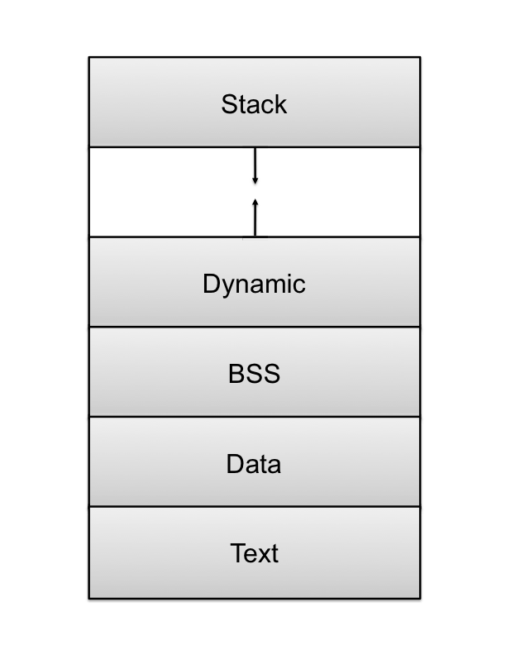
Memory Layout

Slide 16
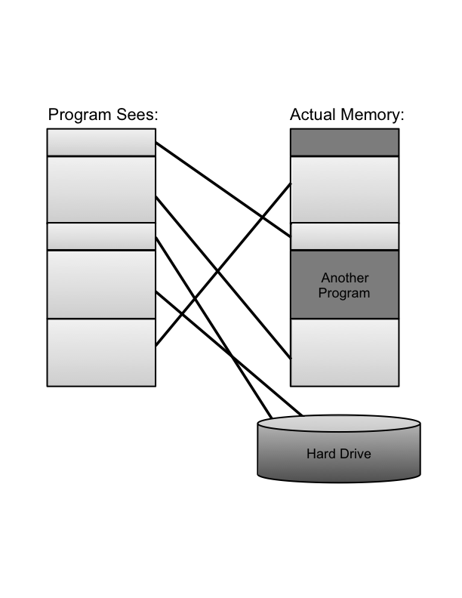
Virtual Memory
There is generally not enough computer memory for the address spaces of all running processes.
Nevertheless, the OS gives each running process the illusion that it has access to its complete (contiguous) address space.
In reality, this view is virtual, in that the OS supports this view, but it is not really how the memory is organized.
Instead, memory is divided into pages, and the OS keeps track of which ones are in memory and which ones are stored out to disk.
ATM

Slide 17
Page Faults
1. Process requests virtual address not in memory,
causing a page fault.
2. Paging supervisor pages out
an old block of RAM memory.
“read 0110101”
“Page fault,
let me fix that.”
Process
Paging supervisor
old
Blocks in
RAM memory:
new
External disk
3. Paging supervisor locates requested block
on the disk and brings it into RAM memory.

Slide 18
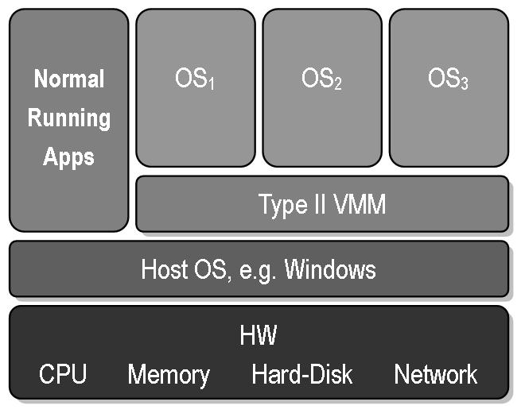
Virtual Machines
Virtual machine: A view that an OS presents that a process is running on a specific architecture and OS, when really it is something else. E.g., a windows emulator on a Mac.
Benefits:
Hardware Efficiency
Portability
Security
Management
Public domain image from http://commons.wikimedia.org/wiki/File:VMM-Type2.JPG

Slide 19
Operating Systems Security

Slide 20
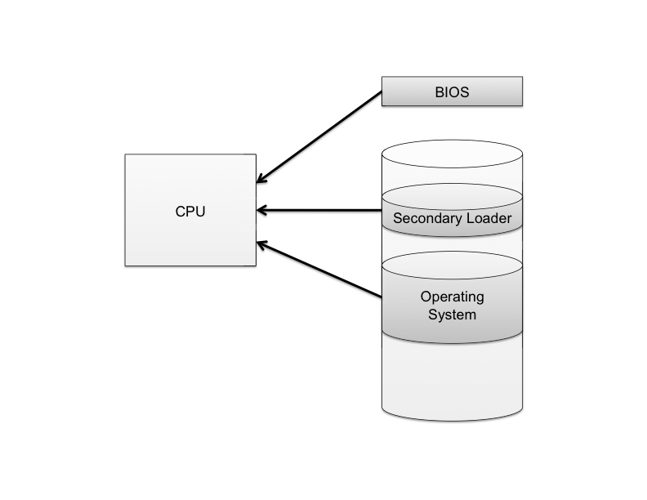
The Boot Sequence
The action of loading an operating system into memory from a powered-off state is known as booting or bootstrapping.
When a computer is turned on, it first executes code stored in a firmware component known as the BIOS (basic input/output system).
On modern systems, the BIOS loads into memory the second-stage boot loader, which handles loading the rest of the operating system into memory and then passes control of execution to the operating system.

Slide 21
BIOS Passwords
A malicious user could potentially seize execution of a computer at several points in the boot process.
To prevent an attacker from initiating the first stages of booting, many computers feature a BIOS password that does not allow a second-stage boot loader to be executed without proper authentication.

Slide 22
Hibernation
Modern machines have the ability to go into a powered-off state known as hibernation.
While going into hibernation, the OS stores the contents of machine’s memory into a hibernation file (such as hiberfil.sys) on disk so the computer can be quickly restored later.
But… without additional security precautions, hibernation exposes a machine to potentially invasive forensic investigation.
1. User closes a laptop computer,
putting it into hibernation.
2. Attacker copies the hiberfil.sys
file to discover any unencrypted
passwords that were stored
in memory when the computer
was put into hibernation.

Slide 23
Event Logging
Keeping track of what processes are running, what other machines have interacted with the system via the Internet, and if the operating system has experienced any unexpected or suspicious behavior can often leave important clues not only for troubleshooting ordinary problems, but also for determining the cause of a security breach.

Slide 24
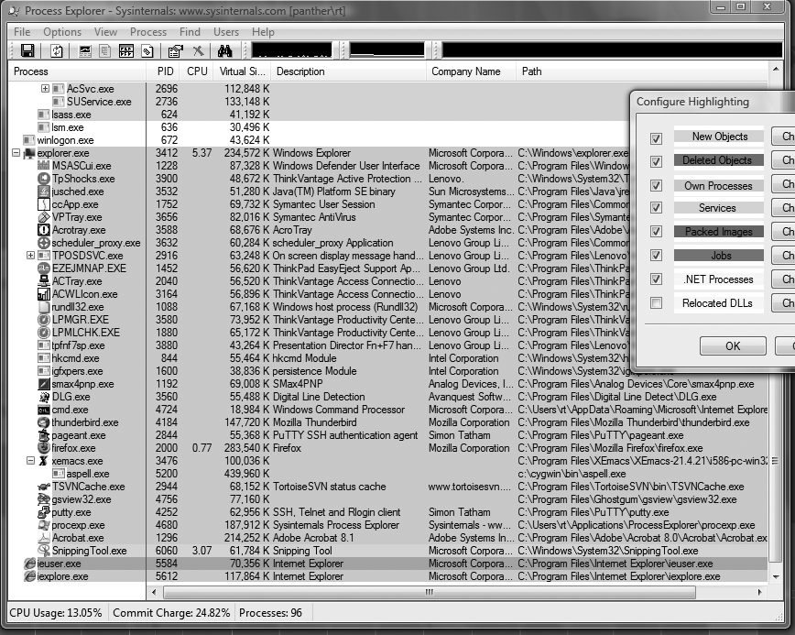
Process Explorer

Slide 25
Memory and Filesystem Security
The contents of a computer are encapsulated in its memory and filesystem.
Thus, protection of a computer’s content has to start with the protection of its memory and its filesystem.

Slide 26
Password Security
The basic approach to guessing passwords from the password file is to conduct a dictionary attack, where each word in a dictionary is hashed and the resulting value is compared with the hashed passwords stored in the password file.
A dictionary of 500,000 “words” is often enough to discover most passwords.

Slide 27
Password Salt
One way to make the dictionary attack more difficult to launch is to use salt.
Associate a random number with each userid.
Rather than comparing the hash of an entered password with a stored hash of a password, the system compares the hash of an entered password and the salt for the associated userid with a stored hash of the password and salt.

Slide 28
How Password Salt Works
Without salt:
1. User types userid, X, and password, P.
2. System looks up H, the stored hash of X’s password.
3. System tests whether h(P) = H.
Password file:
…
X: H
…
With salt:
1. User types userid, X, and password, P.
2. System looks up S and H, where S is the random salt for userid X and H is stored hash of S and X’s password.
3. System tests whether h(S||P) = H.
Password file:
…
X: S, H
…

Slide 29
How Salt Increases Search Space Size
Assuming that an attacker cannot find the salt associated with a userid he is trying to compromise, then the search space for a dictionary attack on a salted password is of size
2^{B}*D,
where B is the number of bits of the random salt and D is the size of the list of words for the dictionary attack.
For example, if a system uses a 32-bit salt for each userid and its users pick passwords in a 500,000 word dictionary, then the search space for attacking salted passwords would be
2³² * 500,000 = 2,147,483,648,000,000,
which is over 2 quadrillion.
Also, even if an attacker can find a salt password for a userid, he only learns one password.

Slide 30
Buffer Overflow Attacks

Slide 31
What is an Exploit?
An exploit is any input (i.e., a piece of software, an argument string, or sequence of commands) that takes advantage of a bug, glitch or vulnerability in order to cause an attack
An attack is an unintended or unanticipated behavior that occurs on computer software, hardware, or something electronic and that brings an advantage to the attacker
Notes:
not necessarily a program... while it can be a program that communicates bad input to a vulnerable piece of software, it can also be just the bad input itself... any bad input (or even valid input that the developer just failed to anticipate) can cause the vulnerable application to behave improperly...

Slide 32
Buffer Overflow Attack
One of the most common OS bugs is a buffer overflow
The developer fails to include code that checks whether an input string fits into its buffer array
An input to the running process exceeds the length of the buffer
The input string overwrites a portion of the memory of the process
Causes the application to behave improperly and unexpectedly
Effect of a buffer overflow
The process can operate on malicious data or execute malicious code passed in by the attacker
If the process is executed as root, the malicious code will be executing with root privileges
Notes:
Because of the nature of the address space, locally declared buffers are allocated on the stack
Since the stack grows downward, if you write past the end of the buffer, you can corrupt the content of the rest of the stack, thus, if enough information is known about the program, one could write over known register information and the return address

Slide 33
Address Space
Every program needs to access memory in order to run
For simplicity sake, it would be nice to allow each process (i.e., each executing program) to act as if it owns all of memory
The address space model is used to accomplish this
Each process can allocate space anywhere it wants in memory
Most kernels manage each process’ allocation of memory through the virtual memory model
How the memory is managed is irrelevant to the process
Notes:
This would also be consistent with the process model proposed earlier where each process feels like it “owns” the machine. The size of the address space is machine dependent, until the Intel 386 came around, most address spaces were 16 bit, for most of the past 15 years, we have been sing 32 bit machines, though increasingly larger number of processors with 64 bit modes are making their way into people’s computers.

Slide 34
Virtual Memory
Program Sees
Actual Memory
Another
Program
Hard Drive
Mapping virtual addresses to real addresses

Slide 35
Unix Address Space
High Addresses
0xFFFF FFFF
Text: machine code of the program, compiled from the source code
Data: static program variables initialized in the source code prior to execution
BSS (block started by symbol): static variables that are uninitialized
Heap : data dynamically generated during the execution of a process
Stack: structure that grows downwards and keeps track of the activated method calls, their arguments and local variables
Stack
Heap
BSS
Data
Text
Low Addresses
0x0000 0000

Slide 36
Vulnerabilities and Attack Method
Vulnerability scenarios
The program has root privileges (setuid) and is launched from a shell
The program is part of a web application
Typical attack method
Find vulnerability
Reverse engineer the program
Build the exploit

Slide 37
Buffer Overflow Attack in a Nutshell
First described in
Aleph One. Smashing The Stack For Fun And Profit. e-zine www.Phrack.org #49, 1996
The attacker exploits an unchecked buffer to perform a buffer overflow attack
The ultimate goal for the attacker is getting a shell that allows to execute arbitrary commands with high privileges
Kinds of buffer overflow attacks:
Heap smashing
Stack smashing

Slide 38
Buffer Overflow
Top of
Memory
0xFFFFFFFF
domain.c
Main(int argc, char *argv[ ])
/* get user_input */
{
char var1[15];
char command[20];
strcpy(command, “whois ");
strcat(command, argv[1]);
strcpy(var1, argv[1]);
printf(var1);
system(command);
}
Stack
Fill
Direction
var1 (15 char)
command
(20 char)
.
.
.
Retrieves domain registration info
e.g., domain brown.edu
Bottom of
Memory
0x00000000

Slide 39
strcpy() Vulnerability
domain.c
Main(int argc, char *argv[])
/*get user_input*/
{
char var1[15];
char command[20];
strcpy(command, “whois ");
strcat(command, argv[1]);
strcpy(var1, argv[1]);
printf(var1);
system(command);
}
Top of
Memory
0xFFFFFFFF
Stack
Fill
Direction
var1 (15 char)
argv[1] (15 char)
argv[1] (20 char)
exploit
Overflow
command
(20 char)
argv[1] is the user input
strcpy(dest, src) does not check buffer
strcat(d, s) concatenates strings
.
.
.
Bottom of
Memory
0x00000000

Slide 40
strcpy() vs. strncpy()
Function strcpy() copies the string in the second argument into the first argument
e.g., strcpy(dest, src)
If source string > destination string, the overflow characters may occupy the memory space used by other variables
The null character is appended at the end automatically
Function strncpy() copies the string by specifying the number n of characters to copy
e.g., strncpy(dest, src, n); dest[n] = ‘\0’
If source string is longer than the destination string, the overflow characters are discarded automatically
You have to place the null character manually

Slide 41
Return Address Smashing
void fingerd (…) {
char buf[80];
…
get(buf);
…
}
f() arguments
previous frames
local variables
return address
EIP
attacker’s input
malicious code
current frame
f() arguments
EIP
next location
return address
padding
buffer
The Unix fingerd() system call, which runs as root (it needs to access sensitive files), used to be vulnerable to buffer overflow
Write malicious code into buffer and overwrite return address to point to the malicious code
When return address is reached, it will now execute the malicious code with the full rights and privileges of root
program code
program code
Notes:
The fragment of C code for fingerd() above shows the problem
A local array buf[80] is declared, which gets allocated on the stack, but the function get does not do bounds checking, and hence makes buffer overflows possible.

Slide 42
Unix Shell Command Substitution
The Unix shell enables a command argument to be obtained from the standard output of another
This feature is called command substitution
When parsing command line, the shell replaces the output of a command between back quotes with the output of the command
Example:
File name.txt contains string farasi
The following two commands are equivalent
finger `cat name.txt`
finger farasi

Slide 43
Shellcode Injection
An exploit takes control of attacked computer so injects code to “spawn a shell” or “shellcode”
A shellcode is:
Code assembled in the CPU’s native instruction set (e.g. x86 , x86-64, arm, sparc, risc, etc.)
Injected as a part of the buffer that is overflowed.
We inject the code directly into the buffer that we send for the attack
A buffer containing shellcode is a “payload”
Notes:
Now comes the question of injecting our own code to be executed. We inject the code directly into the buffer that we send for the attack.

Slide 44
Buffer Overflow Mitigation
We know how a buffer overflow happens, but why does it happen?
This problem could not occur in Java; it is a C problem
In Java, objects are allocated dynamically on the heap (except ints, etc.)
Also cannot do pointer arithmetic in Java
In C, however, you can declare things directly on the stack
One solution is to make the buffer dynamically allocated
Another (OS) problem is that fingerd had to run as root
Just get rid of fingerd’s need for root access (solution eventually used)
The program needed access to a file that had sensitive information in it
A new world-readable file was created with the information required by fingerd
Notes:
Why doesn’t get do a bounds check and why does the operating system allow writing beyond the array bounds?
In Java can’t just overwrite the stack because you don’t know where the stack is!
In Java, cannot access memory without direct access, since we lack pointer arithmetic

Slide 45
Stack-based buffer overflow detection using a random canary
Normal (safe) stack configuration:
Buffer
Other local variables
Canary (random)
Return address
Other data
Buffer overflow attack attempt:
Buffer
Overflow data
Corrupt return address
Attack code
x
The canary is placed in the stack prior to the return address, so that any attempt to over-write the return address also over-writes the canary.

